Slide 1
Considerations when deciding on the scope of the ML platform
Pravin Y Pawar
Adapted from
"Building a Machine Learning Platform [Definitive Guide]"
by Stephen Oladele

Slide 2
Enterprise machine learning platform vs startup ML platform
Especially when meeting data scientists’ needs in an enterprise setting
Two themes for mastering MLOps — Transparency and pure efficiency
because it’s mostly speed and agility that matter
In most startups, data scientists can get away with deploying, testing, and monitoring models ad hoc,
especially with a handful of models
However, in the enterprise, they would waste enormous amounts of time reinventing the wheel with every ML model
which may never result in scalable ML processes for the organization

Slide 3
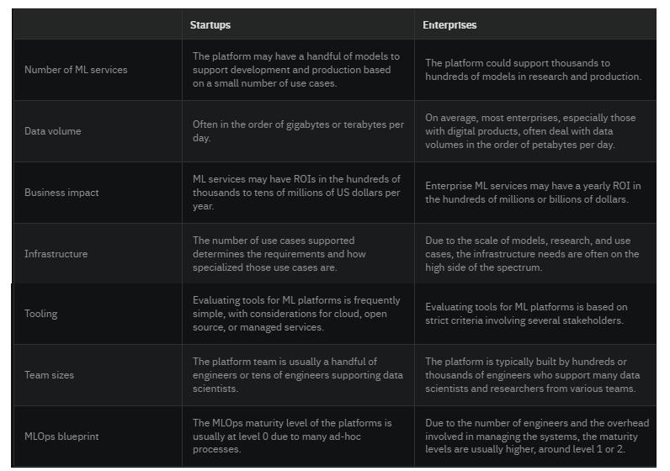
Differences in ML platforms at start-ups compared to enterprises:

Slide 4
Reasonable scale ML platform
In 2021, Jacopo Tagliabue coined the term “reasonable scale,” which refers to companies that:
Have ML models that generate hundreds of thousands to tens of millions of US dollars per year (rather than hundreds of millions or billions)
Have dozens of engineers (rather than hundreds or thousands)
Deal with data in the order of gigabytes and terabytes (rather than petabytes or exabytes)
Have a finite amount of computing budget
A reasonable scale ML platform helps achieve those requirements listed above
Compared to a reasonable scale platform,
a “hyper-scale” platform should support hundreds to thousands of models in production
that likely generate millions to billions of dollars in revenue per year
also have hundreds to thousands of users, support multiple use cases, and handle petabyte-scale data

Slide 5
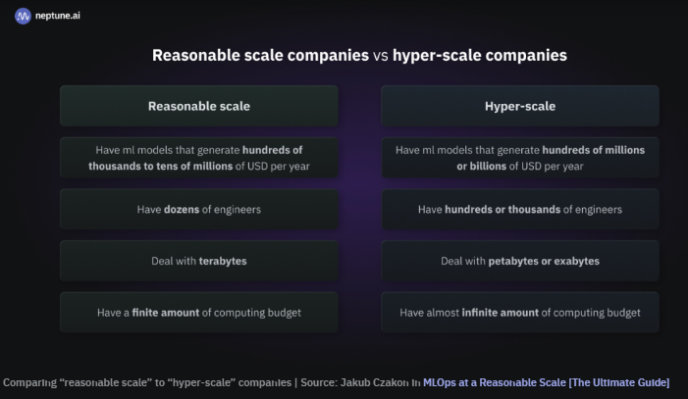
Reasonable scale vs Hyper-scale companies

Slide 6
Data-sensitive ML platform
Data privacy is important when building an ML platform,
but how should sensitive data be kept from being accidentally or maliciously leaked (adversarial attacks)
when data scientists use it for training or inference?
If organizational use cases require privacy protections,
need to build your ML platform with customer and user trust and compliance with laws, regulations, and standards in mind
includes compliance with the data laws of business vertical
Consider building the following into ML platform:
Access controls to data components specifically at an attribute level
Use or build tools to anonymize datasets and protect sensitive information
Use or build data aggregation tools to hide individual information
Add tools for modeling threats and analyzing data leakages to identify gaps in privacy implementation and fix them
Useful tools and frameworks to build data-sensitive components as part of ML platform:
Tensorflow Privacy
ML Privacy Meter
PySyft
CrypTFlow

Slide 7
Human-in-the-loop ML platforms
Human oversight is crucial for every ML platform!
As much as you’d like to automate every component of the platform to make your life and that of your data scientists easier,
it’s most likely not going to be possible
For example,
finding “unknown unknowns” of data quality problems on platforms that use new data to trigger retraining feedback loops might be hard to automate
And when the platform automates the entire process, it’ll likely produce and deploy a bad-quality model
Your components need to have interfaces that relevant stakeholders and subject matter experts can interact with to evaluate data and model quality
need to design the platform with them to understand
the components that require manual evaluation
those that can be solved with automated monitoring

Slide 8
Building an ML platform for special industry verticals
Across different industries and business verticals, the use cases and ML product goals will differ
can be difficult to build a platform that caters to most use cases
one of the reasons why an all-size-fits-all ML platform may not work for most teams!
Need a platform built on components that can be flexible to handle different objects and are reusable across use cases.
The major considerations to make when planning an ML platform across special industry verticals include:
Data type:
For the different types of use cases team works on, what’s the most prevalent data type, and can ML platform be flexible enough to handle them?
Model type:
How would you build your platform to allocate development and production resources effectively?
Legal requirements:
What are the legal and governance requirements the platform needs to comply with, from the data component to the predictions that get to the end users?
Team structure and collaboration:
How is the team working on this use case structured, and what stakeholders would be actively involved in the projects the platform needs to serve?

Slide 9
End to end vs canonical stack ML platform
You can
buy an end-to-end ML platform that would seem to solve all your platform needs
or build a canonical stack of point solutions based on each component
Ultimately, deciding whether to get one platform or mix and match different solutions will be
very context-dependent
and dependent on understanding where your business is as well as your users
There are certainly pros and cons to both approaches!

Slide 10
Closed vs open end-to-end ML platform
Closed platforms will generally provide an ecosystem
that would potentially allow for seamless integrations across entire stack
but would likely confine to that ecosystem in what’s known as a “lock-in.”
With open platforms,
can easily swap components and leverage open-standard tools
can provide flexibility for team and get them to adopt and use the tool without too much overhead
For example,
with Kubeflow, an open-source ML platform, can swap out components easily,
whereas that’s not the case with a closed solution like DataRobot (or Algorithimia)
When it comes to a managed or open source ML platform,
it all depends on the existing infrastructure as well as other build vs. buy decisions made
If organization runs its workloads on AWS, it might be worth it to leverage AWS SageMaker.

Slide 11
Thank You!
In our next session:

